Slide 1








Inspiring Choices
Literacy Project

Slide 2
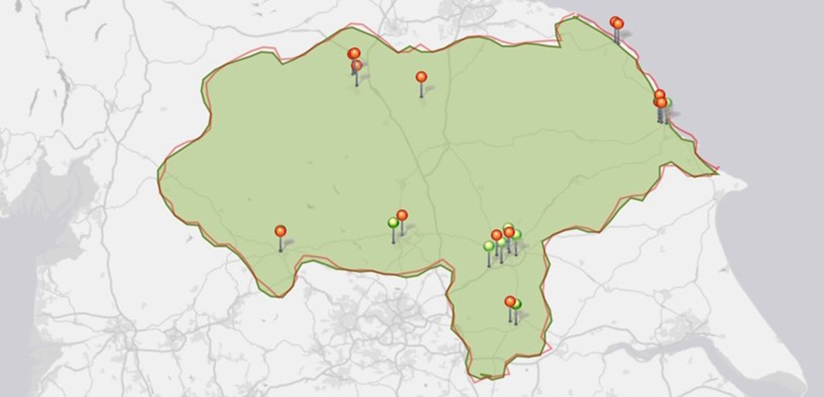
WHO ARE INSPIRING CHOICES?
York and North Yorkshire
Inspiring Choices are the York & North Yorkshire partnership for the Uni Connect programme, run by the Office for Students. Inspiring Choices are here to support young people as they make decisions about their future education and career! ​
We work with young people aged 14 and above and run workshops, activities and trips. We also offer 1-2-1 support and bespoke activities for schools and colleges. ​

Slide 3
Project development
Back in early 2022 when the OfS sent out a planning framework for attainment raising projects, we decided we wanted the aims of our project to be:
· Providing targeted academic support to learners
· Tackling non-academic barriers to learning
Speaking to school contacts and an academic at the university who also marks GCSE papers, it became clear that low literacy levels were impacting on all areas of curriculum for some learners.

Slide 4

Project development continued
Having looked at literacy data on HEAT, 2 schools were identified in North Yorkshire
This is to be a sustained engagement from September 2023- July 2024

Slide 5

Collaboration
Discussion with YSJU Employer Engagement and Student Opportunities Manager about using university graduates to complete training and deliver this project
As one of the school is on the coast, we had a discussion with a local university about using their current 2nd year primary education students to train and deliver the project
YSJU graduate applicants interviewed and 3 selected to participate in training

Slide 6

Aims of the project
Work with pupils significantly under the national reading and writing levels.
Improve confidence in reading and writing across the curriculum
Once identified struggling readers, aim to raise reading and writing levels

Slide 7
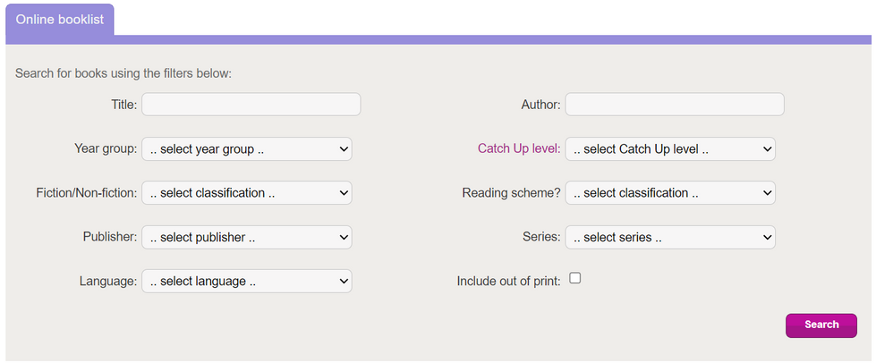

Working with Catch Up
  Approached Catch Up Literacy charity to deliver the training to coordinators and graduates.
  3 x2 hour intensive sessions. The sessions go through how to assess a pupils reading and writing levels, subsequently how to conduct the 15 minute individual sessions.
  After completion of training sessions, Catch Up Literacy certificated which is a recognised qualification in schools.
  Access to online booklist- which books are Catch Up Literacy approved.

Slide 8
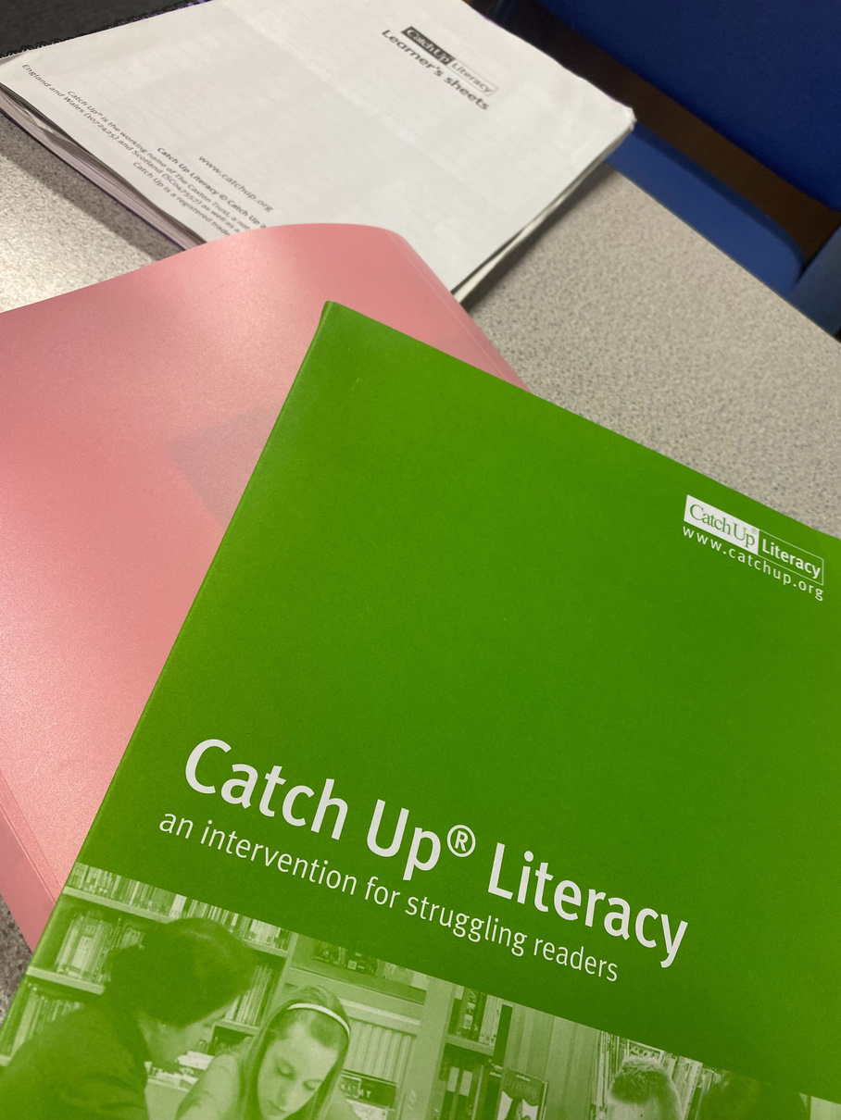

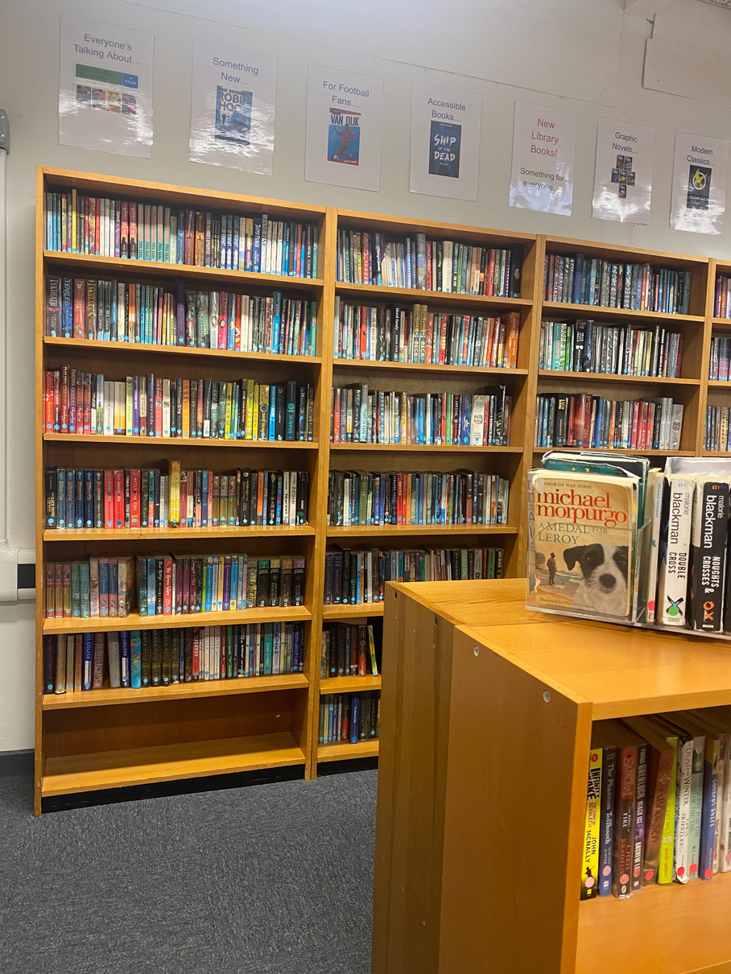
Logistics
Mentoring in action
  Working with a North Yorkshire school, identified as a school in need of support
  Each member of staff works with 4 x Year 7 pupils (boys) who have a significantly below average reading and writing score.
  Delivering the sessions three times per week (15 minutes per session, per pupil)

Slide 9


Evaluation
As part of the initial Catch Up Literacy assessment, we asked each pupils a set of questions, such as:
Do you have any books of your own?
What do you think reading is?
Do you think it is important to be able to read?
How do you feel if someone asks you to read out loud?

Slide 10
Evaluation: results
Here are some examples of the positive results we found, after the 10 week intervention...
Enthusiasm
“I have bought an entire shelf of new books”
“I have a collection of Diary of a Wimpy Kid books”
“More Marcus Rashford books”
Confidence
When asked how do you feel if someone asks you to read out loud, one response was..
“Much better, as I can help others read now. I feel more confident”
Behavioual improvement
“I used to find it difficult to copy off the board but now I can read and write from the board. I don’t get warnings from the teachers now for not writing.”

Slide 11
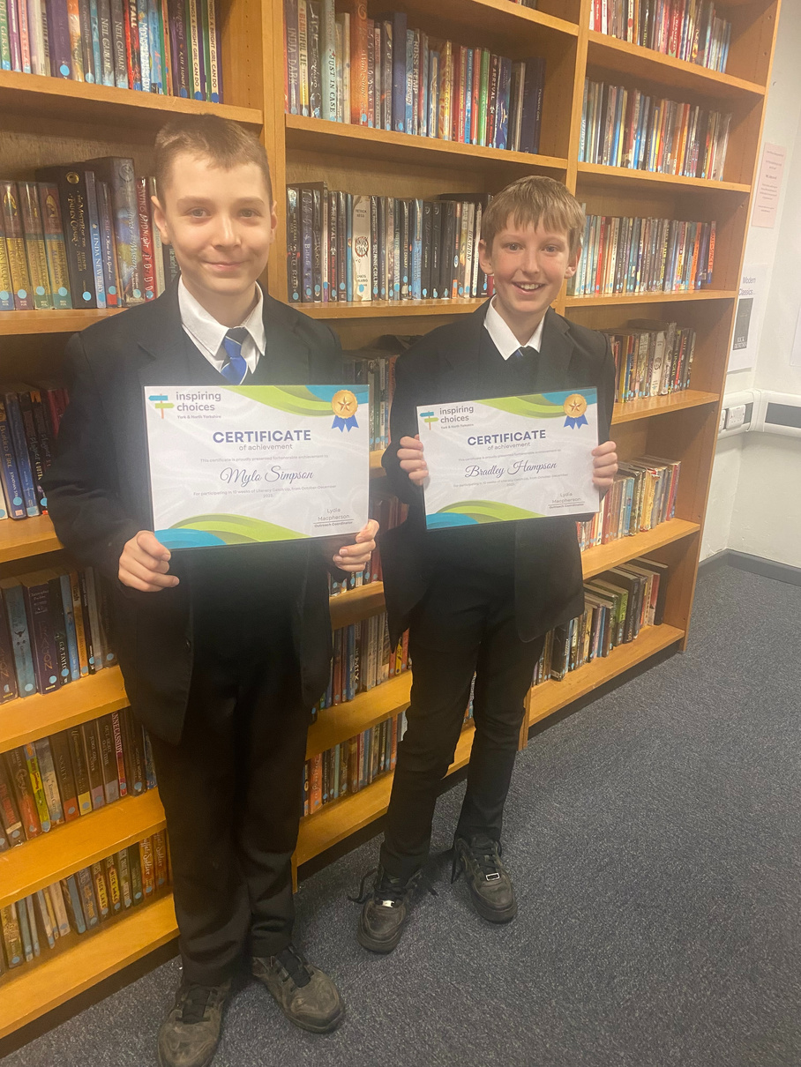

Case study
Year 7 pupil Bradley was identified as significantly below the national writing and writing levels for his age. Through the 10 week intervention, Bradley improved from a level 6 to level 10.
In addition, Bradley stated that he enjoyed the sessions, particularly the 1:1 element.

Slide 12
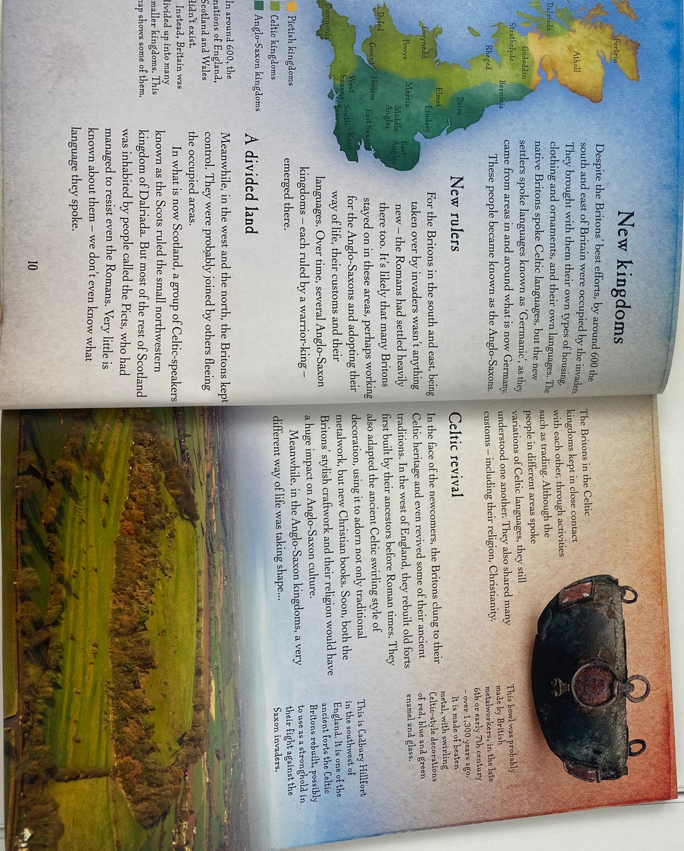
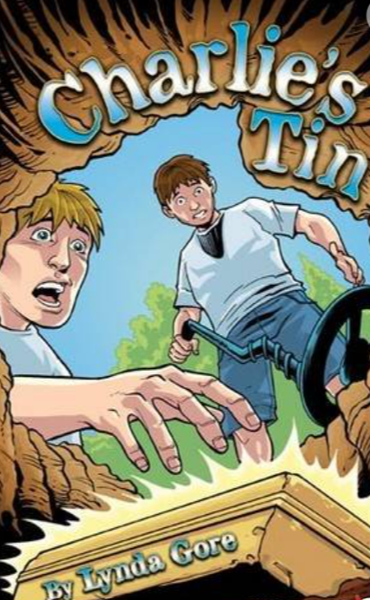
Catch Up books
Level 6 Catch up book
Level 10 Catch up book

Slide 13


Where we are now
When:
3 times a week, 15 minute sessions per pupil. January- April 2024
Where:
School on the North Yorkshire coast
Who:
Working with 8 x Year 8 pupils- boys who have been identified by English lead at school

Slide 14




FIND OUT MORE
Check out our website, and follow us on social media!
inspiring-choices.co.uk
@inspchoices_uc
@inspiring.choices.uc

Slide 15

Any Questions?

